Slide 1


CSCI 5541: Natural Language Processing
Lecture 3: Text Classification
James Mooney

Slide 2
Announcements
Homework 1 has been released (new due date: Feb 6)
TA office hours have been posted on the course site
Project formation is due Feb. 6
UNITE lectures should be present immediately on canvas for non-UNITE students
Recitation content + lecture PowerPoints will be uploaded after class today

Slide 3
Outline
Tutorial on building text classifier using Scikit-Learn and PyTorch (Risako)
Applications of text classification
Why is sentiment analysis difficult?
How can we build a sentiment classifier?

Slide 4

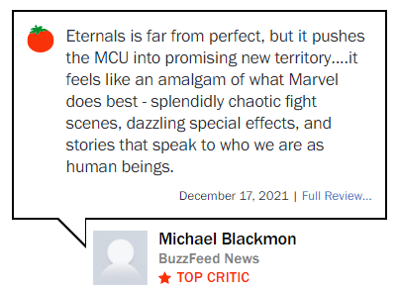
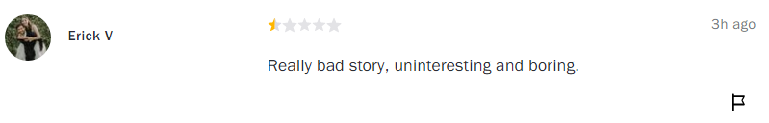
Movie review

Slide 5
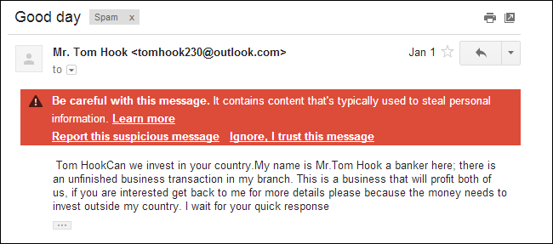
Spam detection

Slide 6

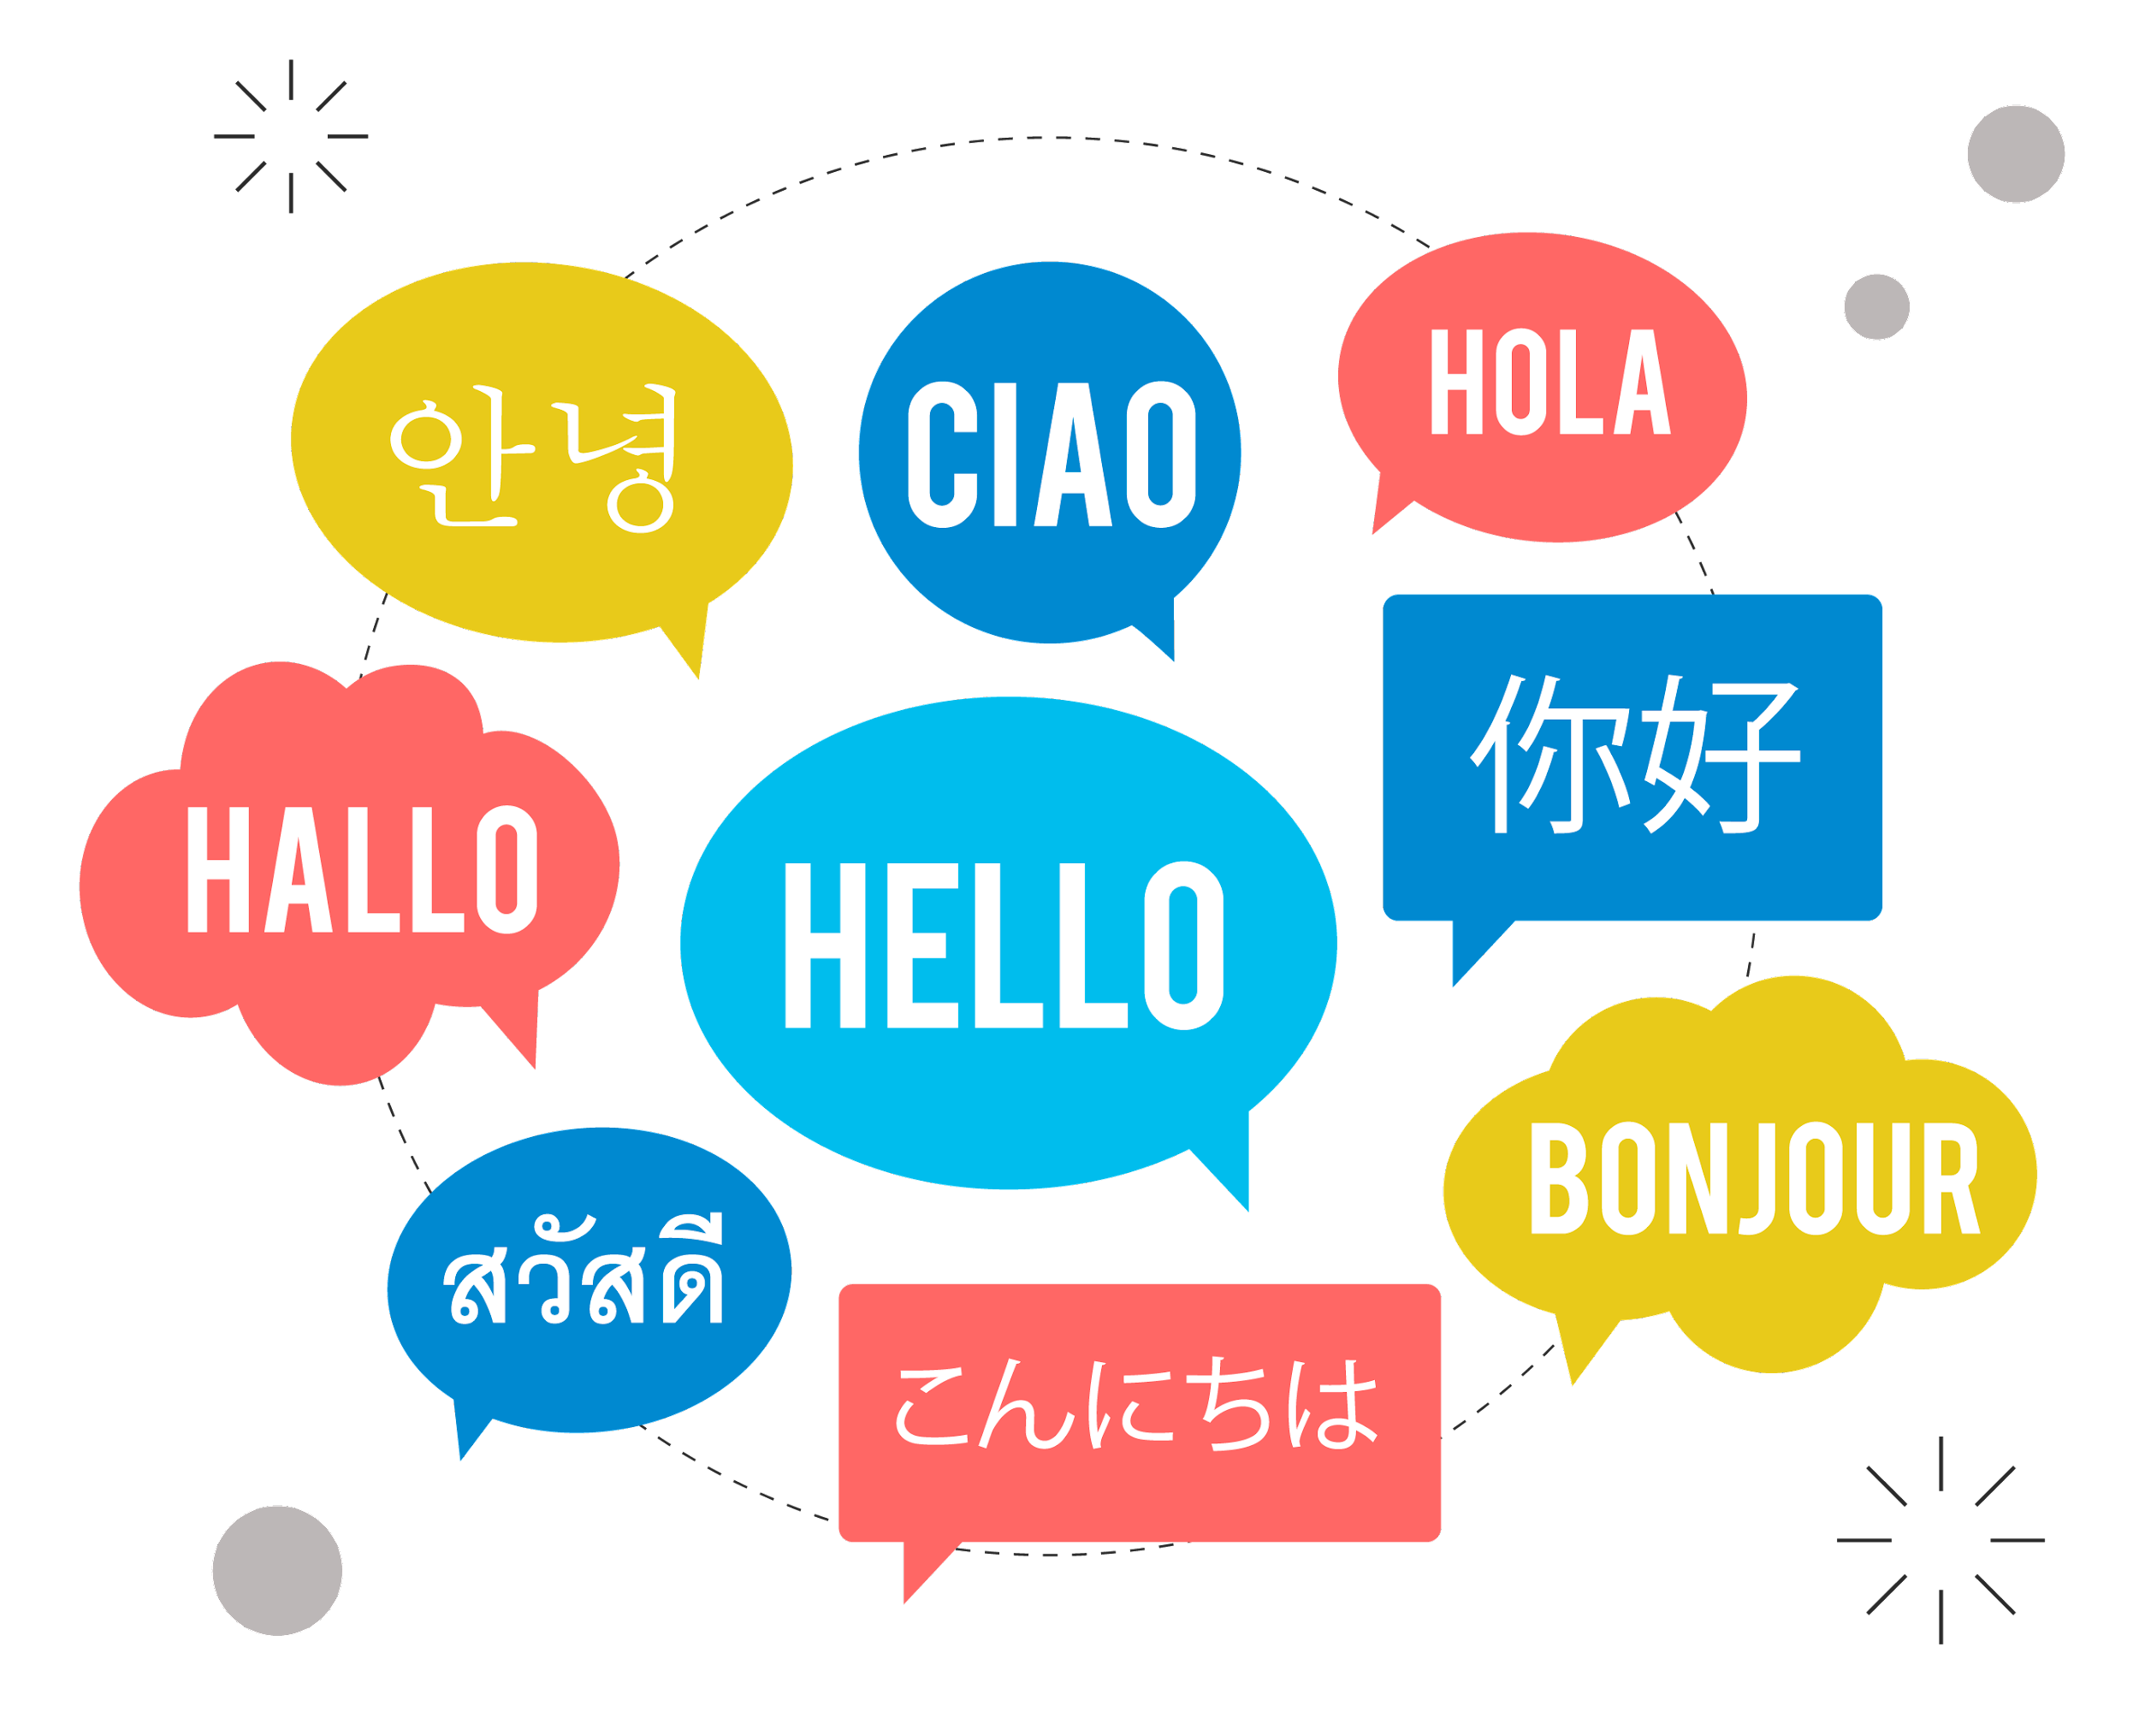
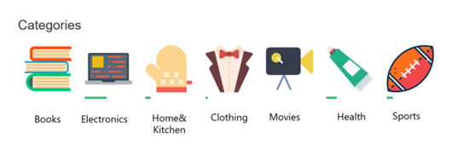
Language Identification
Authorship Identification
Topic/Genre Assignment

Slide 7

Why is sentiment analysis
difficult?

Slide 8
There was an earthquake in California
The team failed to complete physical challenge. (We win/lose!)
They said it would be great.
They said it would be great, and they were great.
They said it would be great, and they were wrong.
Oh, you’re terrible!
Long-suffering fans, bittersweet memories, hilariously embarrassing moments
Examples from Chris Potts

Slide 9
Scherer Typology of Affective States
Emotion: brief organically synchronized … evaluation of a major event
angry, sad, joyful, fearful, ashamed, proud, elated
Mood: diffuse non-caused low-intensity long-duration change in subjective feeling
cheerful, gloomy, irritable, listless, depressed, buoyant
Attitudes: enduring, affectively colored beliefs, dispositions towards objects or persons
liking, loving, hating, valuing, desiring
Interpersonal stances: affective stance toward another person in a specific interaction
friendly, flirtatious, distant, cold, warm, supportive, contemptuous
Personality traits: stable personality dispositions and typical behavior tendencies
nervous, anxious, reckless, morose, hostile, jealous

Slide 10
Difficulty of task
Simplest task:
Is the attitude of this text positive or negative (or neutral)?
More complex:
Rank the attitude of this text from 1 to 5
Advanced:
Detect the target (stance detection)
Detect source
..

Slide 11
What makes reviews hard to classify? Subtlety
“If you are reading this because it is your darling fragrance, please wear it at home exclusively, and tape the windows shut.”
Perfume review in Perfumes: the Guide

Slide 12
What makes reviews hard to classify? Thwarted expectations and ordering effects
“This film should be brilliant. It sounds like a great plot, the actors are first grade, and the supporting cast is good as well, and Stallone is attempting to deliver a good performance. However, it can’t hold up..”
“Well as usual Keanu Reeves is nothing special, but surprisingly, the very talented Laurence Fishbourne is not so good either, I was surprised.”

Slide 13



What makes reviews hard to classify? Subjectivity and degree of sentiment
Positive
A: I got 3 veggies and a side of fries for over a 11 dollars if you like homecooked food
B: She listened to my ideas, asked questions to get a better idea about my style, and was excellent at offering advice as if I were a total pleb.
Negative
Neutral
Annotation Records
Extractive
A is preferably more positive than B. (A > B)
Crowd Workers
Subjective
B is preferably more positive than A. (A < B)
“Prefer to Classify: Improving Text Classifiers via Auxiliary Preference Learning”, ICML 2023

Slide 14
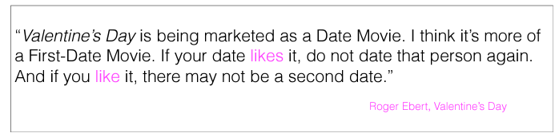
Why is sentiment analysis hard ?
Sentiment is a measure of a speaker’s private state, which is unobservable.
Sentiment is contextual;
Words are a good indicator of sentiment (love, hate, terrible); but many times it requires deep world + contextual knowledge
Deep understanding of language behaviors (e.g., politeness)

Slide 15
Related Tasks
Subjectivity (Pang & Lee 2008)
Stance (Anand et al., 2011)
Hate-speech (Nobata et al., 2016)
Sarcasm (Khodak et al., 2017)
Deception and betrayal (Niculae et al., 2015)
Online trolls (Cheng et al., 2017)
Politeness (Danescu-Niculescu-Mizil et al., 2013)
…

Slide 16
How can we build a sentiment classifier?

Slide 17
Supervised Learning
Given training data in the form of <x, y> pairs, learn f(x)
X | Y
I loved it! | Positive
Terrible movie. | Negative
Not too shabby | Positive
Such a lovely movie! | Positive

Slide 18
Learning f(x)
Two components:
The formal structure of the learning method:
f: how x and y are mapped
Logistic regression, Naïve Bayes, RNN, CNN, etc
The representation of the data (x)

Slide 19
Representation of data (x)
Only positive/negative words in sentiment dictionaries
Only words in isolation
Conjunctions of words
Linguistic structures
..

Slide 20
Sentiment Dictionaries
General Inquirer (1996)
MPQA subjectivity lexicon (Wilson et al., 2005)
http://mpqa.cs.pitt.edu/lexicons/subj_lexicon/
LIWC (Pennebaker 2015)
AFINN (Nielsen 2011)
NRC Word-Emotion Association Lexicon (EmoLex) (Mohmmad and Turney, 2013)
Positive | Negative
unlimited | lag
prudent | contortions
superb | fright
closeness | lonely
impeccably | tenuously
fast-paced | plebeian
treat | mortification
destined | outrage
blessing | allegations

Slide 21
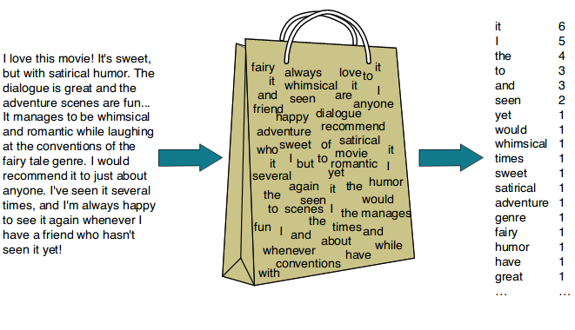
Dictionary Counting
Positive | Negative
unlimited | lag
prudent | contortions
superb | fright
closeness | lonely
impeccably | tenuously
fast-paced | plebeian
treat | mortification
destined | outrage
blessing | allegations
happy | 1
love | 2
recommend | 2
lonely | 0
outrage | 0
not | 2

Slide 22

Limitation?
happy | 1
love | 2
recommend | 2
f ( ) = y
lonely | 0
outrage | 0
not | 2

Slide 23
Representation of data (x)
Only positive/negative words in sentiment dictionaries
Only words in isolation (bag-of-words)
E.g., good, bad
Conjunctions of words (sequential, high-order n-grams, skip n-grams, etc)
E.g., “not good”, “not bad”
Linguistic structures (Part-of-speech, etc)
..

Slide 24
Bag of words
Representation of text only as the counts of words that it contains

Slide 25
f ( ) = y

Slide 26
Representation of data (x)
Only positive/negative words in sentiment dictionaries
Only words in isolation (bag-of-words)
Conjunctions of words (sequential, high-order n-grams, skip n-grams, etc)
Linguistic structures (Part-of-speech, etc)
..

Slide 27
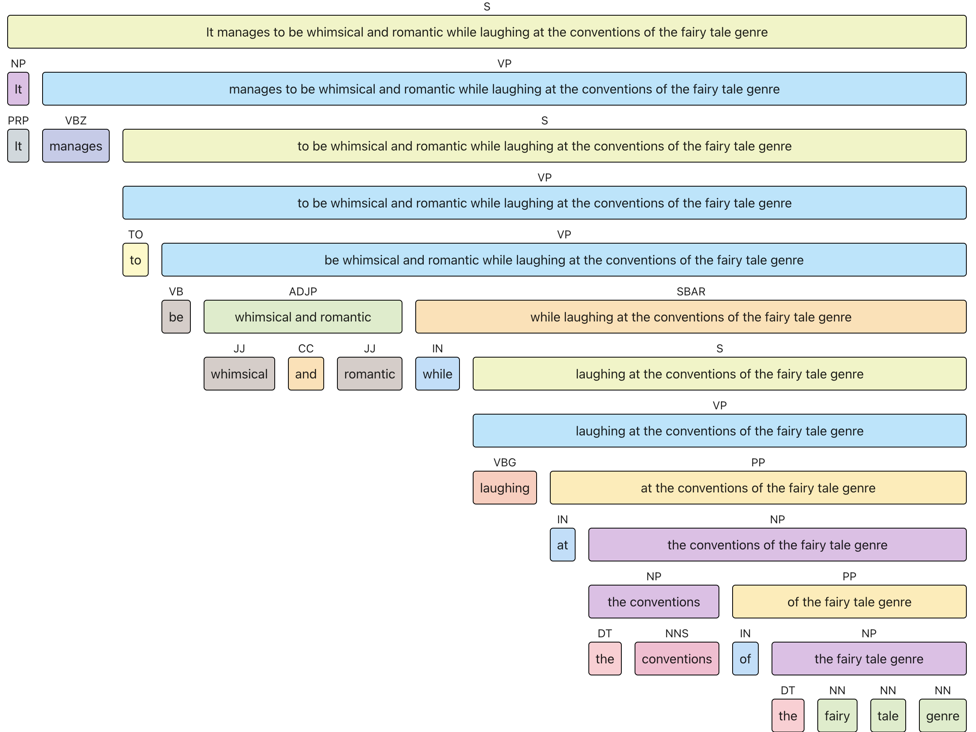
Linguistic Structures
Count the number of part-of-Speech, depth of constituency parses, etc
Parse depth | 5
NP | 5
VP | 2
.. | ..
https://parser.kitaev.io

Slide 28
f ( ) = y
NP | 5
VP | 2
Parse depth | 5

Slide 29
How to implement f(x)=y using Python?
Two components:
The formal structure of the learning method:
f: how x and y are mapped
Logistic regression, Naïve Bayes, RNN, CNN, etc
The representation of the data (x)

Slide 30
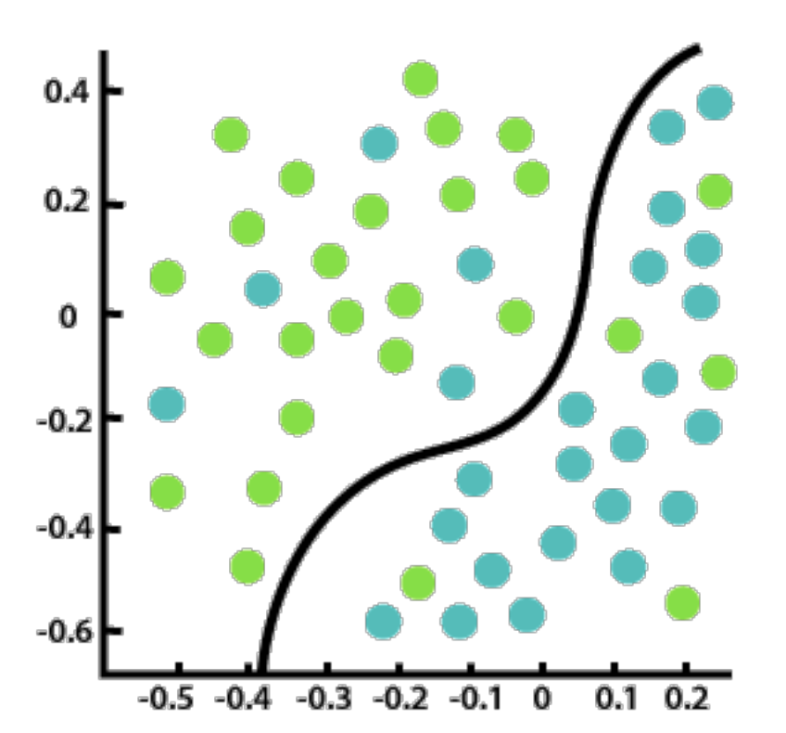
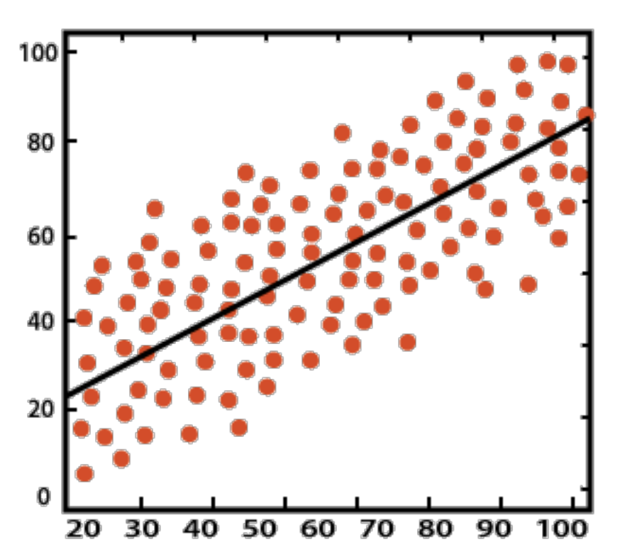
Classification vs Regression

Slide 31
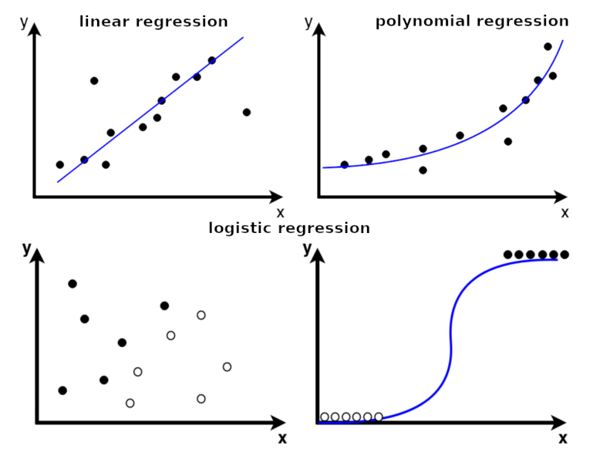

Slide 33
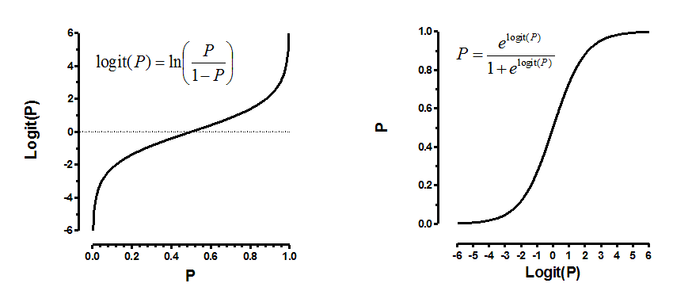
Probability 101: Logit(P) and Logistic Regression

Slide 34
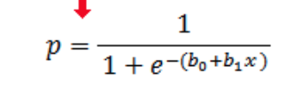
Logistic regression

Slide 35
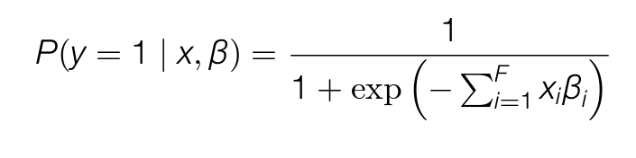
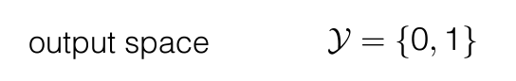
Binary logistic regression
Model parameters to learn

Slide 36
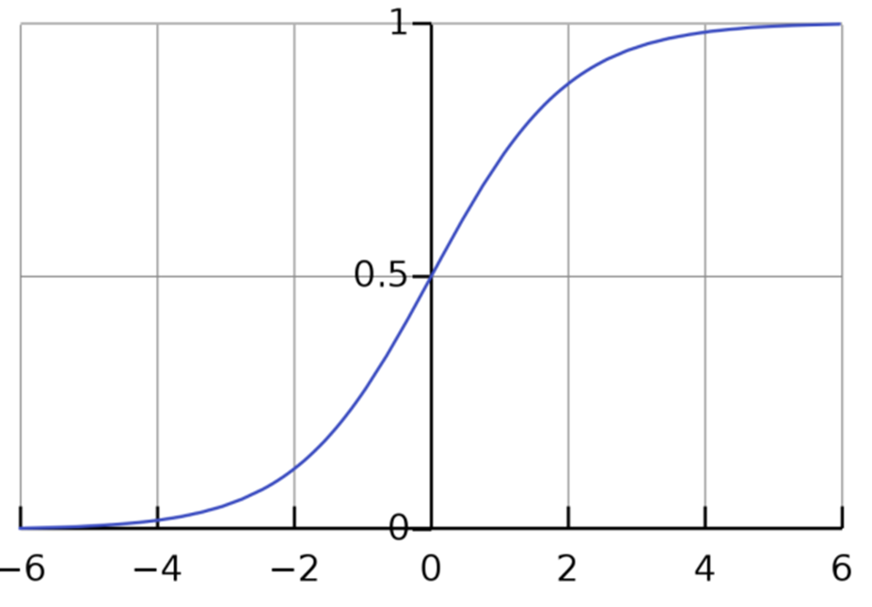
Binary logistic regression
f ( x ) = y

Slide 37

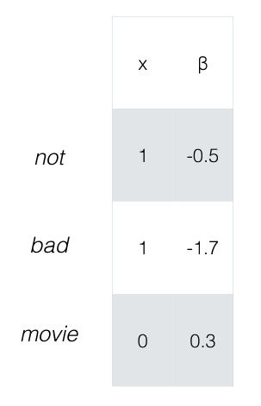
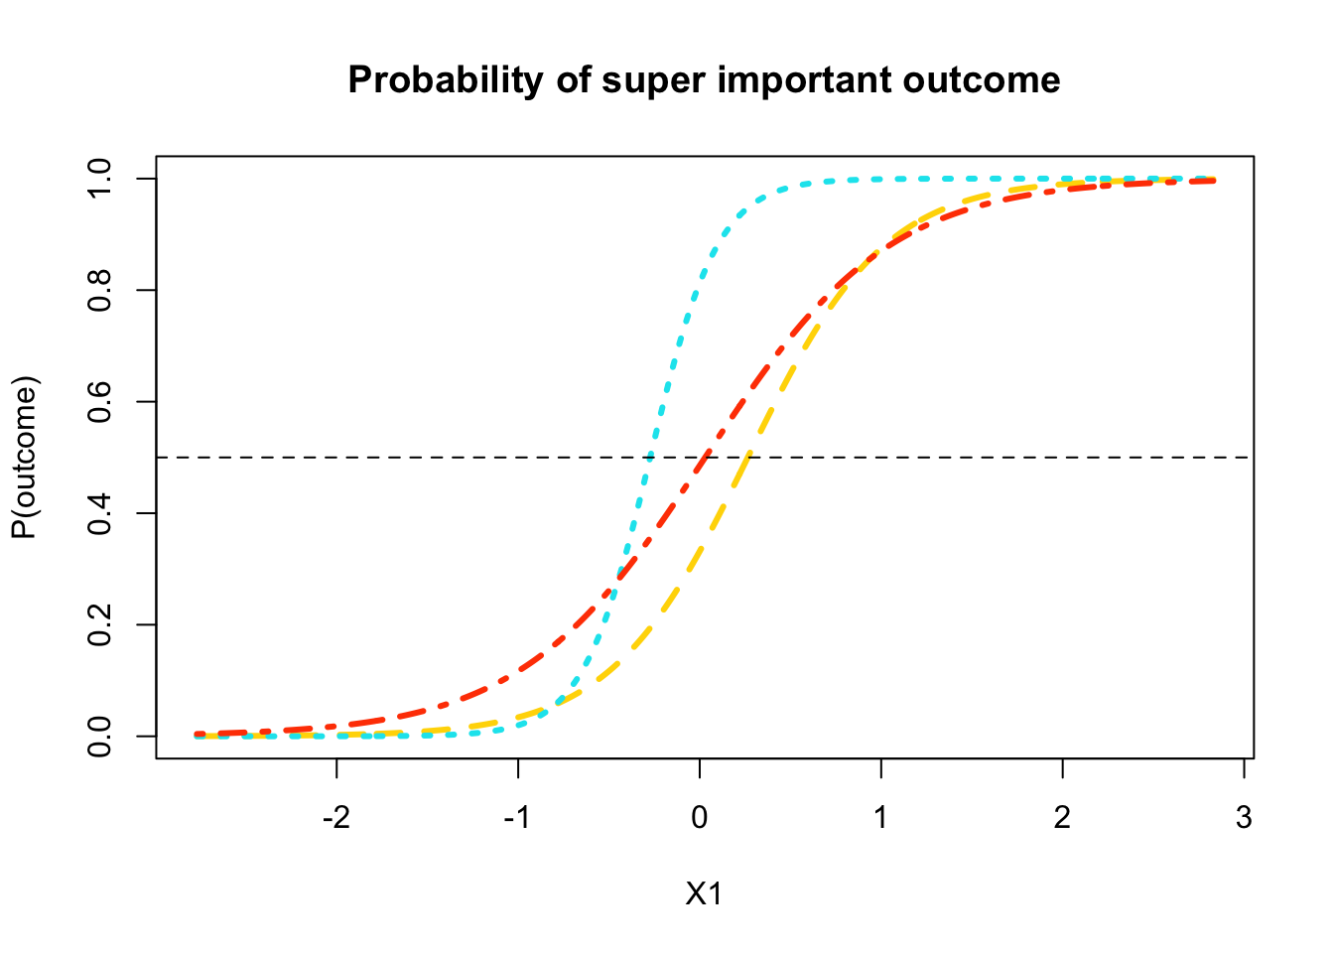

Slide 38
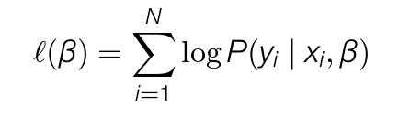
Logistic regression
We want to find the value of β that leads to the highest value of the conditional log likelihood:
-

Slide 39
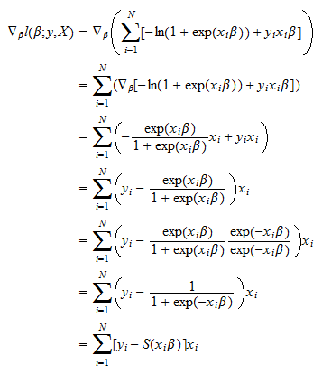
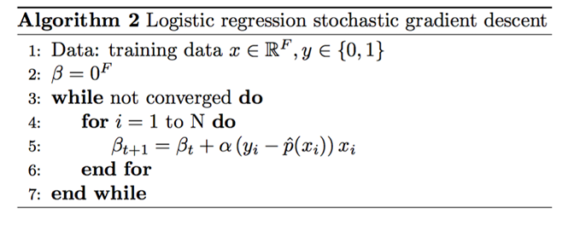
Logistic regression
We want to find the value of β that leads to the highest value of the conditional log likelihood:
Train it with stochastic gradient descent

Slide 40
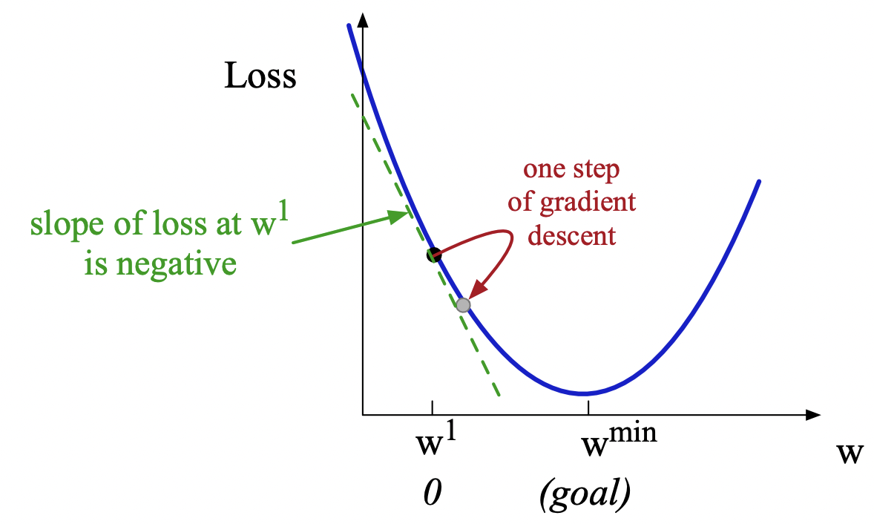
Gradient Descent (why does it work)

Slide 41
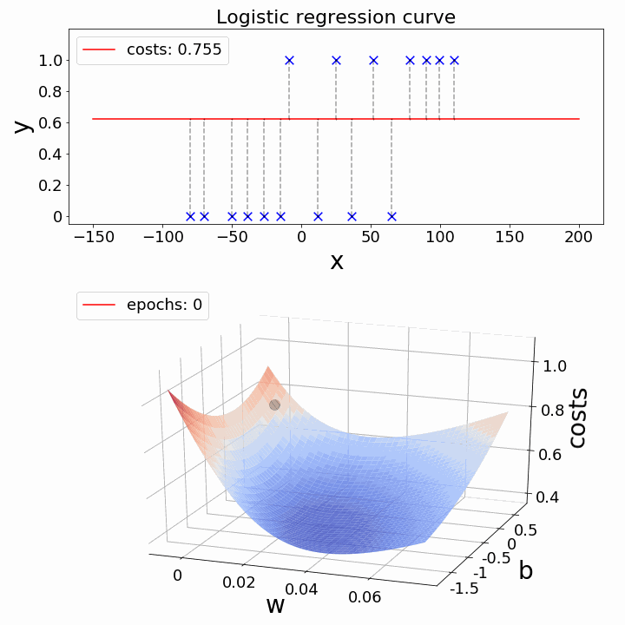

Slide 42
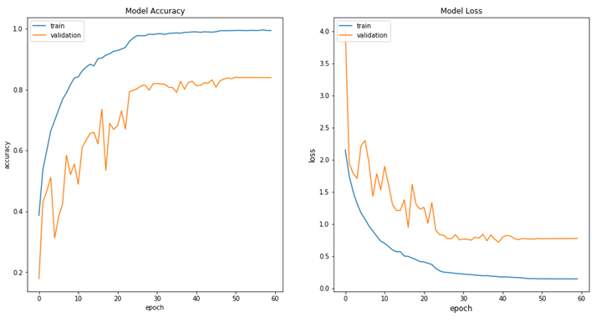
Loss curve
Accuracy curve

Slide 43
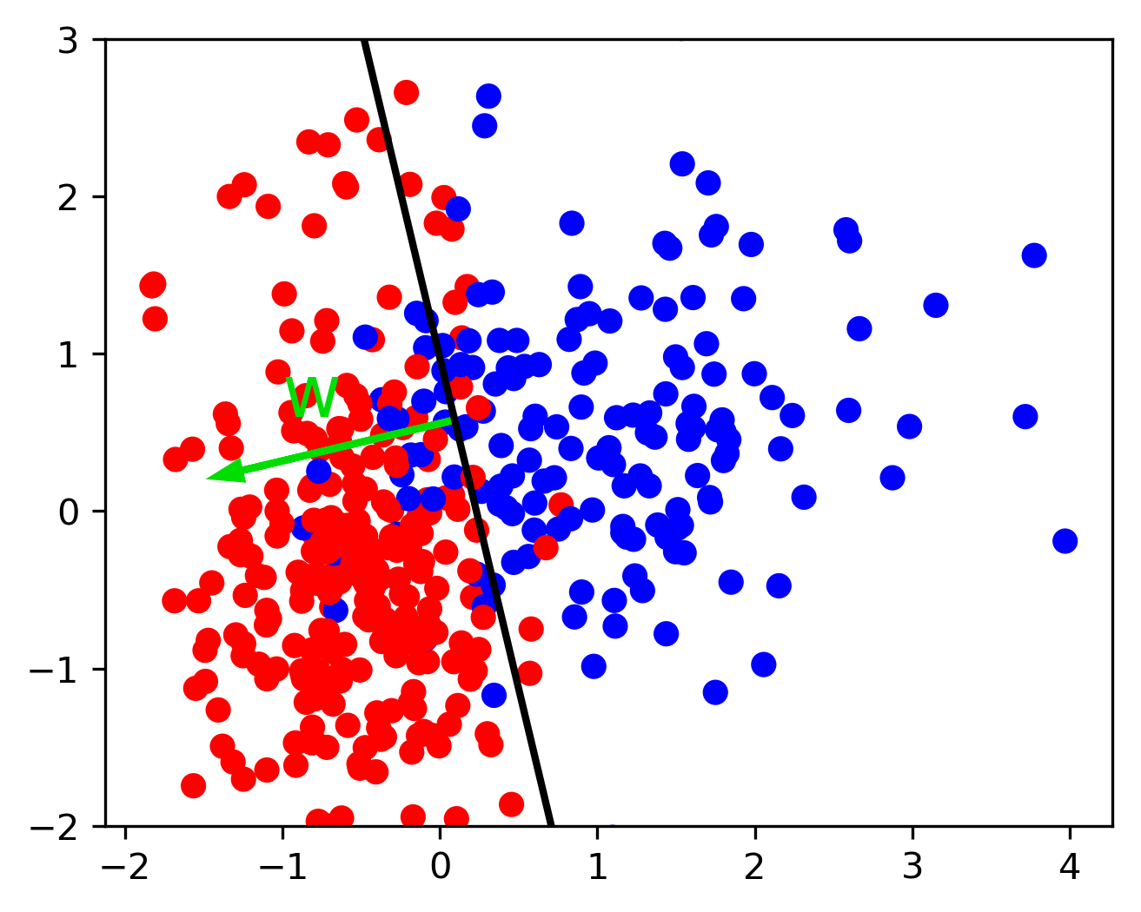
The Final Logistic Classifier
Linear
Parameters define a separating hyperplane in the space of x
Bias defines offset from origin

Slide 44
How to implement f(x)=y using Python?
Two components:
The formal structure of the learning method:
f: how x and y are mapped
Logistic regression, Naïve Bayes, RNN, CNN, etc
The representation of the data (x)

Slide 45
Representation of data (x)
As a discriminative classifier, logistic regression doesn’t assume features are independent like Naive Bayes does.
Its power partly comes in the ability to create richly expressive features without the burden of independence.
We can represent text through features that are not just the identities of individual words, but any feature that is scoped over the entirety of the input.
Features
Unigrams (“like”)
Bigrams (“not like”), trigrams, etc
Prefixes (word that start with “un-”
Words that appear in the positive/negative dictionary
Reviews begin with “I love”
At least 3 mentions of positive verbs (like, love, etc)

Slide 46
Representation of data (x)
I want 1
have you 2
how many 2
isn’t it 1
…
Features
Unigrams (“like”)
Bigrams (“not like”), trigrams, etc
Prefixes (word that start with “un-”
Words that appear in the positive/negative dictionary
Reviews begin with “I love”
At least 3 mentions of positive verbs (like, love, etc)
f ( )=y
happy | 1
love | 2
recommend | 2
lonely | 0
outrage | 0
not | 2
NP | 5
VP | 2
Parse depth | 5

Slide 47
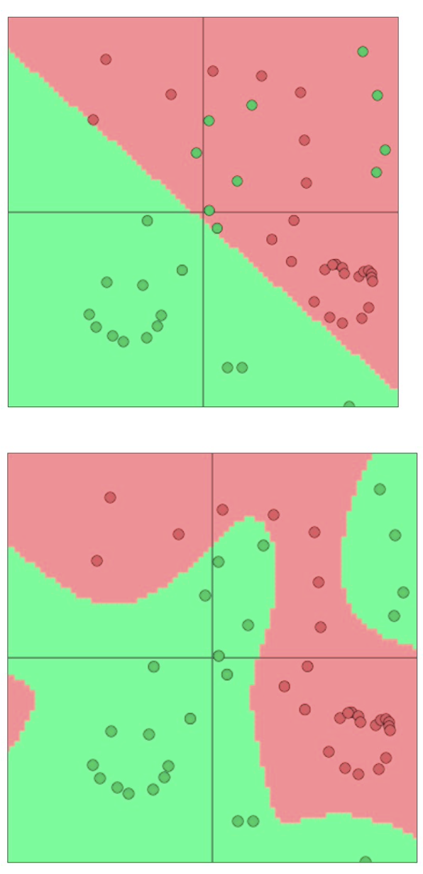
What if your input representation is complex and cannot be modeled by simple linear projection?

Slide 48
Neural Networks
Discrete, high-dimensional representation of inputs (one-hot vectors) => low-dimensional “distributed” representations.
Distributional semantics and word vectors (To be covered)
Static representations -> contextual representations, where representations of words are sensitive to local context.
Contextualized Word Embeddings (To be covered)
Multiple layers to capture hierarchical structure

Slide 49
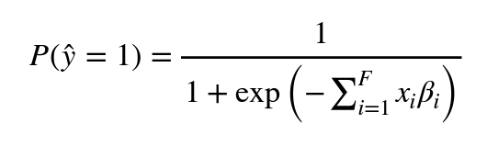
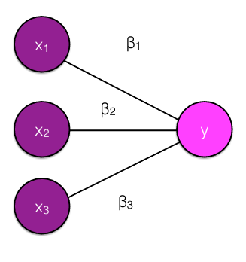
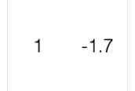
Recap: Logistic regression
“It’s not a bad movie”
not a bad

Slide 50
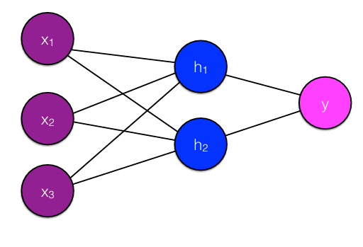
Feedforward neural network
Input and output are mediated by at least one hidden layer.

Slide 51
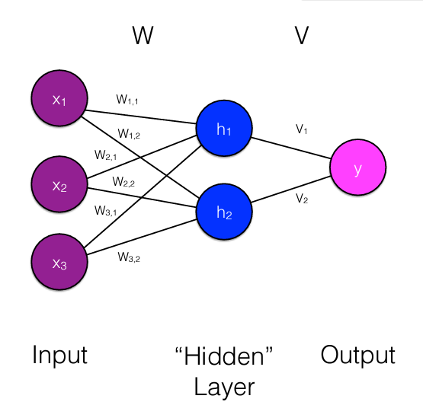
*For simplicity, we’re leaving out the bias term, but assume most layers have them as well.

Slide 52
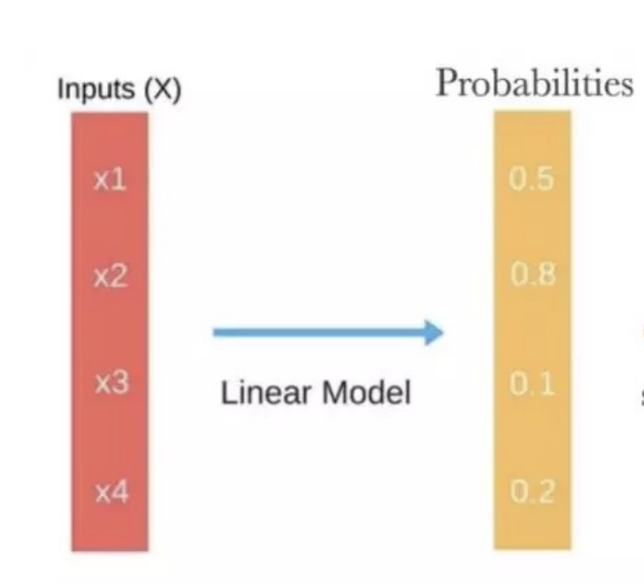
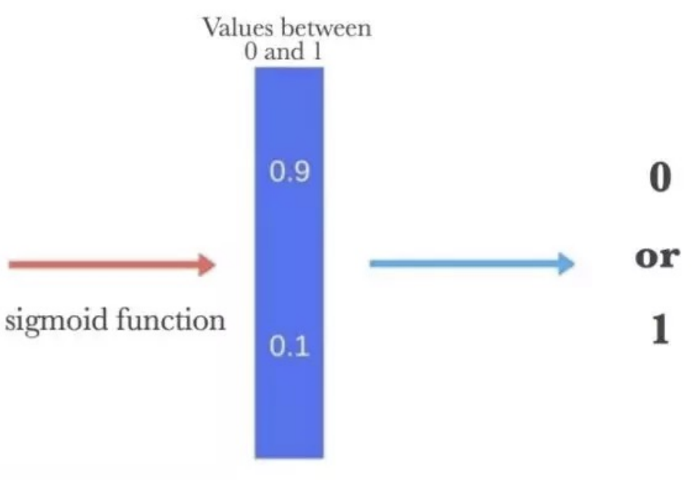
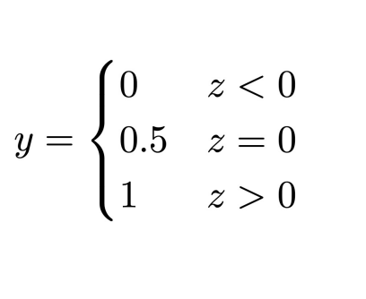
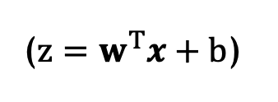
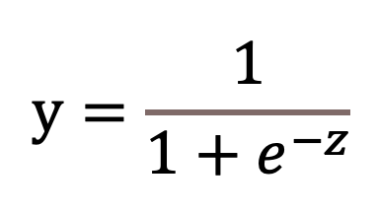
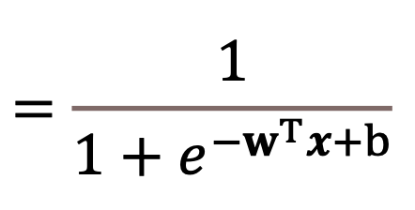
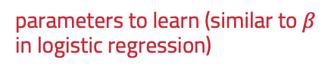
MLP: Relations with logistic regression
parameters to learn
parameters to learn (similar to $β$ in logistic regression)

Slide 53
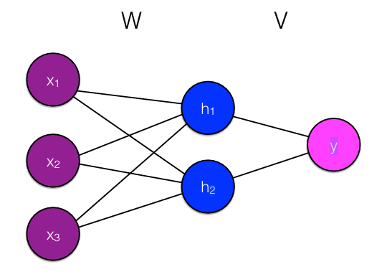
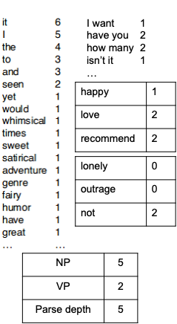
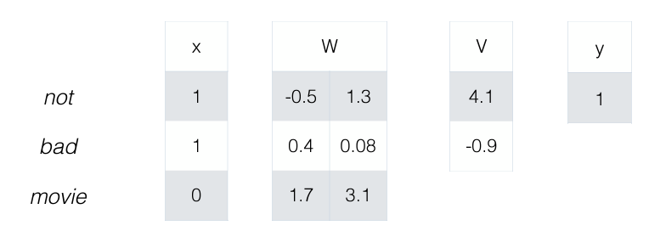

Slide 54
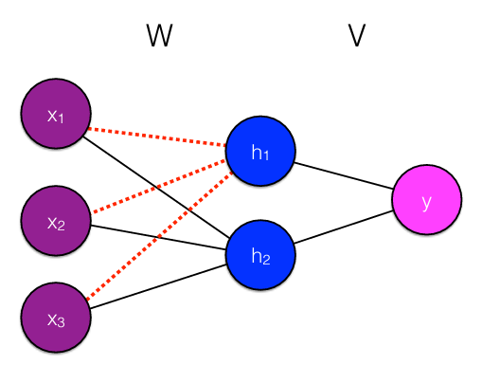
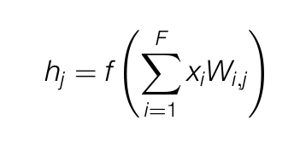
the hidden nodes are completely determined by the input and weights

Slide 55
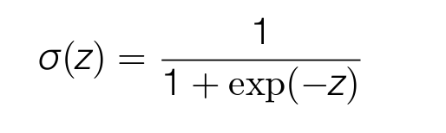
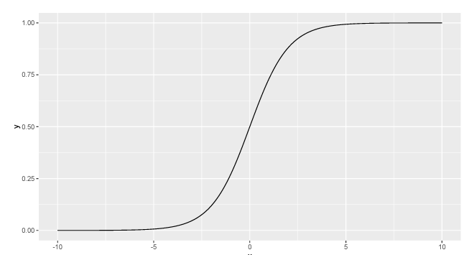
Activation functions
Squeezing outputs between 0 and 1

Slide 56
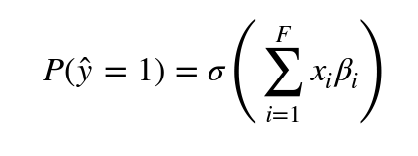
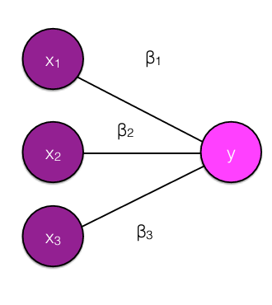
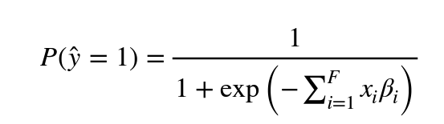
Activation functions
Squeezing outputs between 0 and 1
We can think about logistic regression as a neural network with no hidden layers

Slide 57
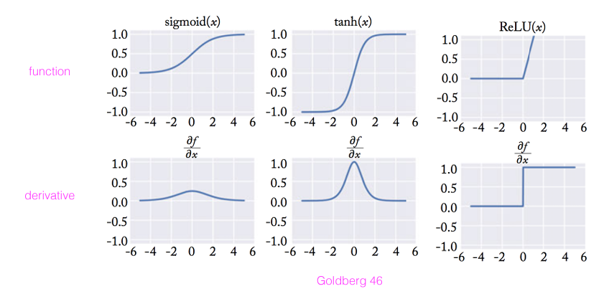
Activation functions
Squeezing outputs between 0 and 1
Sigmoid is useful for final layer to scale output between 0 and 1, but is not often used in intermediate layers.
ReLU and tanh are both used extensively in modern systems.
Check out the derivative
Goldberg 46

Slide 58
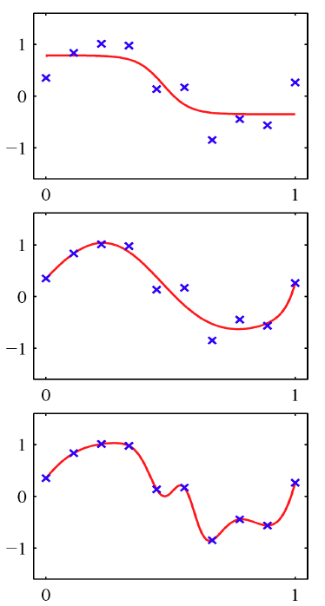

Non-linearities (i.e., $f$): why they’re needed?
Neural nets do function approximation
E.g., regression or classification
Without non-linearities, deep neural nets can’t do anything more than a linear transform.
Extra layers could just be complied down into a single linear transform: $W_{1}W_{2}x=Wx$
But, with more layers that include non-linearities, they can approximate more complex functions

Slide 59

Linear models include translation, rigid (translation + rotation), similarity (translation + rotation + scale), affine and projective transformations. Nonlinear models, which consider non-linear transformations allow for more complex deformations.
New techniques for motion-artifact-free in vivo cardiac microscopy

Slide 60


Slide 61


Slide 62

This is differentiable via backpropagation
Backpropagation: Given training samples of <x,y> pairs, we can use stochastic gradient descent to find the values of W and V that minimize the loss.

Slide 63


Slide 64

Neural networks are a series of functions chained together
The loss is another function chained on top

Slide 65



Chain rule

Slide 66

Forward and Backward Propagation
https://medium.com/deeper-deep-learning-tr/ad%C4%B1m-ad%C4%B1m-forward-and-back-propagation-cf4cd18276ee

Slide 67


Backpropagation
Forward and backward propagation
Compute value/gradient of each node with respect to previous nodes
Good news is that modern automatic differentiation tools do this all for you!
Deep learning nowadays is like modular programming

Slide 68


Slide 69


Slide 70




Slide 71
Other tricks in neural network training
Avoid overfitting with dropout
Average/max/min pooling
Smart initialization
Adaptive learning rate control than SGD
Gradient clipping
Early stopping with validation set
Hyper-parameter tuning
…

Slide 72
Feedforward Neural Network (i.e., Single-layer Perceptron)

Slide 73

Feedforward Neural Network (i.e., Two-layer Perceptron)
HW1

Slide 74
Finetuning from pretrained weights
HW2

Slide 75




Other neural network models
Convolution NN
Recurrent-NN/LSTM/GRU
Recursive NN
Self-attention / Transformers
Graph Convolutional / Neural Network

Slide 76


Overfitting
A model that perfectly match the training data that has a problem
It will also overfit to the data, modeling noise
A random word that perfectly predicts y (it happens to only occur in one class) will get a very high weight.
Failing to generalize to a test set without this word.
A good model should be able to generalize

Slide 77

Cross validation
Break up “training” data into 5 folds
For each fold
Choose the fold as a temporary test set
Train on 5 folds, compute performance on test fold
Report average performance of the 5 runs
Find the best parameters
https://scikit-learn.org/stable/modules/cross_validation.html

Slide 78
State of the Art

Slide 79

https://paperswithcode.com/

Slide 80


Slide 81

Robustness of Neural Classifiers
Ribeiro et al., Beyond Accuracy: Behavioral Testing of NLP Models with CheckList, ACL 2020

Slide 82
Robustness of Neural Classifiers
Ribeiro et al., Beyond Accuracy: Behavioral Testing of NLP Models with CheckList, ACL 2020

Slide 83
Robustness of Neural Classifiers
Ribeiro et al., Beyond Accuracy: Behavioral Testing of NLP Models with CheckList, ACL 2020

Slide 85


Interpretability: why? learning dataset, not task
Human: Polite BERT: Polite
I will understand if you decline, but would very much like you to accept. May I nominate you?
Human
BERT
Both
Hayati et al., Does BERT Learn as Humans Perceive? Understanding Linguistic Styles through Lexica

Slide 86
Run yourself
https://huggingface.co/datasets/sst2

Slide 87
Summary
Various applications using sentiment analysis in political and social sciences, stock market prediction, advertising, etc.
Sentiment of text is reflection of the speaker's private state, which is hardly observable.
Lexicon dictionaries have limitations, because sentiment is contextual
Sentiment + X
Modern deep representations perform better but are hard to interpret, and easy to be biased to the dataset
97.5 accuracy on SST2, but poor robustness in practice

Slide 88
Questions
Is there any way to take advantages from both the classical dictionary based method and modern neural model?
How can we evaluate and improve robustness of the model? How can we collect even more challenging samples that the current best model can’t predict well?
How can we make black-box deep learning models to be more interpretable?
Is benchmarking/leader-boarding a good practice for evaluation? If not, what is the solution?

